Slide 1
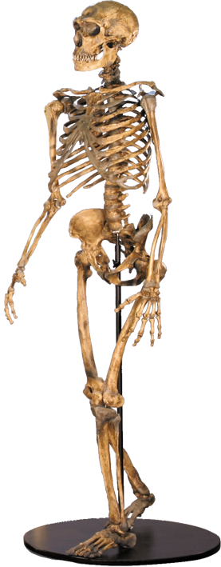
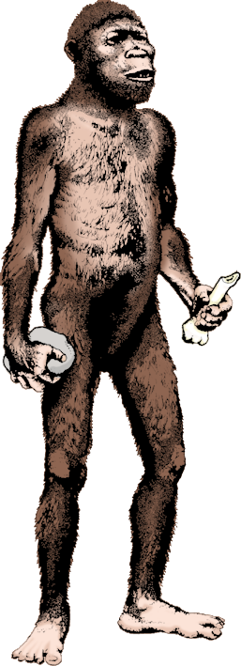
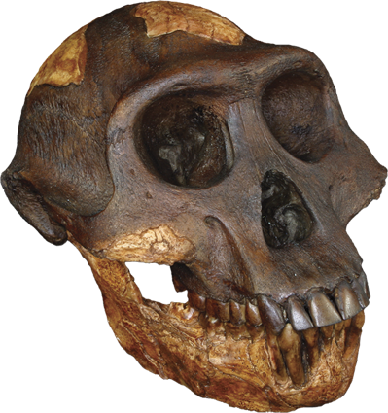
Hominin Evolution Trends

Slide 2
New definitions
New definitions
The most commonly used recent definitions are:
Hominid – the group consisting of all modern and extinct Great Apes (that is, modern humans, chimpanzees, gorillas and orang-utans plus all their immediate ancestors).
Hominin – the group consisting of modern humans, extinct human species and all our immediate ancestors (including members of the genera Homo, Australopithecus, Paranthropus and Ardipithecus).

Slide 3
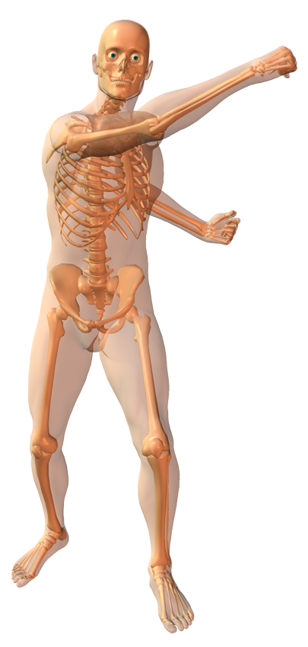
Human Characteristics
Brain became enlarged
High forehead
Head held vertically
Teeth covered with thick enamel, reduced molars, small canines
Reduced neck muscles
Shortened forelimb
Reduced lower back with S-shaped curvature
Fully opposable thumb
Short, wide pelvis for attachment of gluteal muscles for walking
Leg bones are thickened and longer
Femoral head angled and strengthened
Reduction in body hair to increase evaporative cooling
Buttress at knee-joint to allow bipedal walking
Foot has an arch with weight-bearing heel and ball
Non-opposable and forward thrusting big toe

Slide 4
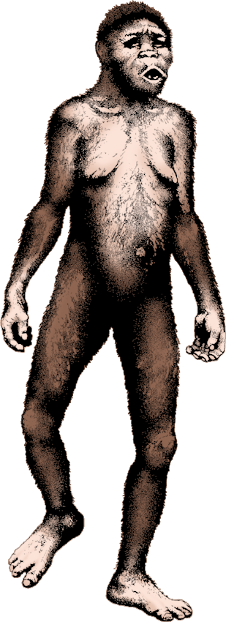
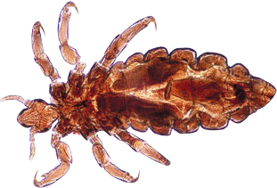
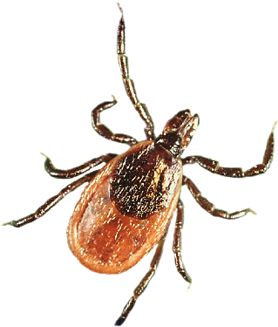
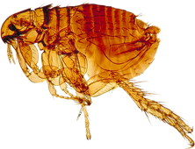
Selection For Nakedness
Hair Louse
Retention of head hair:
Hair on the head (and to a lesser extent the shoulders) reflects and radiates solar radiation (heat) before it reaches the skin.
Soft Tick
Flea
Thermoregulation:
Shorter, finer hairs (not hair loss) in early hominins allowed greater heat loss by increasing radiation from the skin surface. Well developed sweat glands allow us to lose heat at an astounding 700 watts m⁻² of skin (a capacity not approached by any other mammal).
Parasite control:
Reduced body hair improves control of ectoparasites such as fleas, ticks, and lice. Particularly important when early hominins began to use a regular 'home base', as hatching parasite eggs could reinfect them.

Slide 5
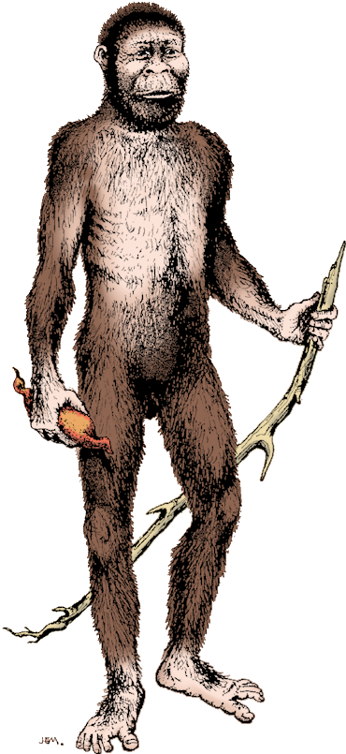
Selection For Bipedalism
Seeing over the grass may have helped to spot predators or locate carcasses at a distance.
Carrying offspring while following the large game herds of the savannah on long seasonal migrations.
Holding tools and weapons
was probably a consequence of bipedalism, rather than a cause.
Carrying food away from a kill site or growing site to a position of safety.
Thermoregulation:
Two major advantages of walking are:
• Smaller surface area presented to the sun at midday (60% less).
• Greater air flow across the body when it is lifted higher off the ground assists cooling.
Efficient Locomotion:
Bipedalism provides an energy efficient method that favors low speed, long distance movement – walking.

Slide 6
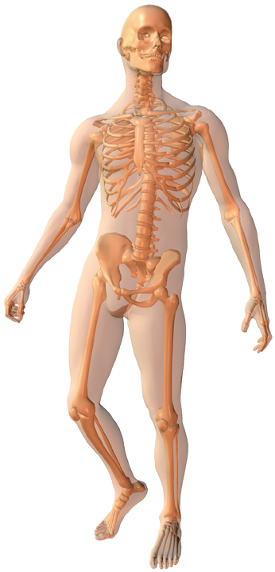
Adaptations for Bipedalism
Position of Foramen Magnum: Located more centrally under the skull, so that the skull is balanced on the spine
Spine Shape: Lower back is reduced to produce an 'S' shape that has the effect of keeping the head and torso above the centre of gravity
Femur: Longer and angled inwards from the hips so that the knees nearly touch. This “carrying angle” assists in positioning the upper body over the centre of gravity.
Pelvis Shape: Short and broad, for attachment of large, powerful muscles for walking. Pelvis has become more 'bowl-shaped' to provide support for the organs of the torso.
Knee Joint: Bottom of the femur (knee joint) has a buttress of bone (called the lateral condyle). This stops the sideways deflection of thigh muscles during walking.
Shape of Foot: The anatomy of the foot has changed to become a platform. Toes are short, with big toe forward thrusting. Inner side of the foot is elevated into an arch to provide shock absorption.

Slide 7
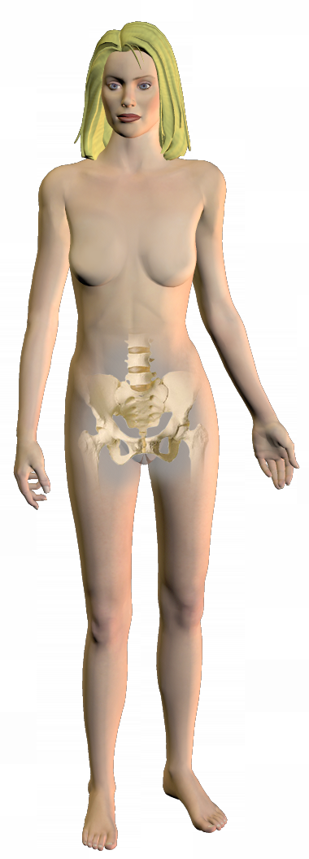
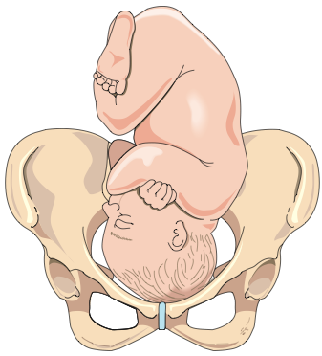
Problems Caused by Bipedalism
Hernias: The intestines may bulge out through our weakened abdominal wall. This is the result of our gut no longer being hung from the spine by a broad ligament as it is in quadrupeds; the problem is compounded by obesity.
Slipped disc: Lower back troubles, usually the result of degenerative changes with age, are compounded by the load being carried by only two limbs
Birth canal (in women): Changes in pelvic shape in response to bipedalism, together with babies born with larger skulls, cause childbirth problems.
Varicose Veins: An upright posture hampers venous return, allowing blood to collect in the leg veins. Blood must overcome about 1.2 m of gravitational pressure to return to the heart.
Flat Feet: Feet may suffer strain because the body rests on just two limbs. The arches of the feet collapse resulting in flat footedness, distorted bones, hammer toes, and bunions.

Slide 8
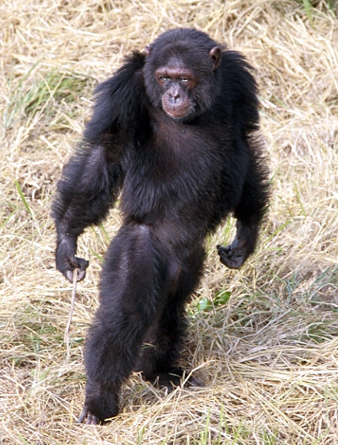
Bipedalism
Of all the primates, only humans are habitually bipedal. Some primates will occasionally walk using just two legs when it suits them, such as this chimpanzee.
Humans too may occasionally exhibit ape-like locomotion - a throwback to our primate ancestry.

Slide 9
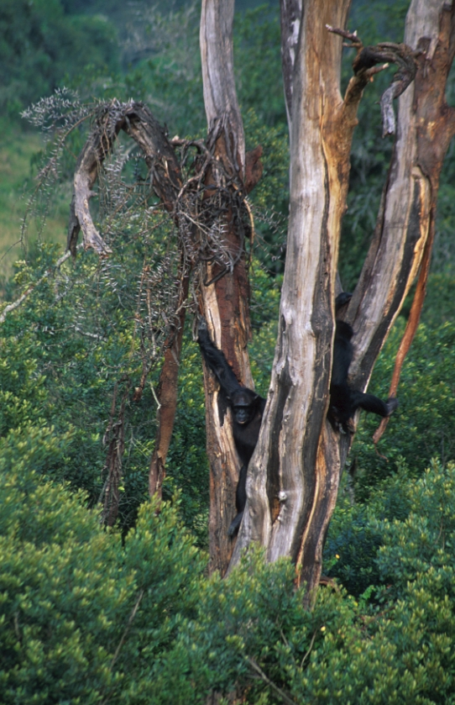
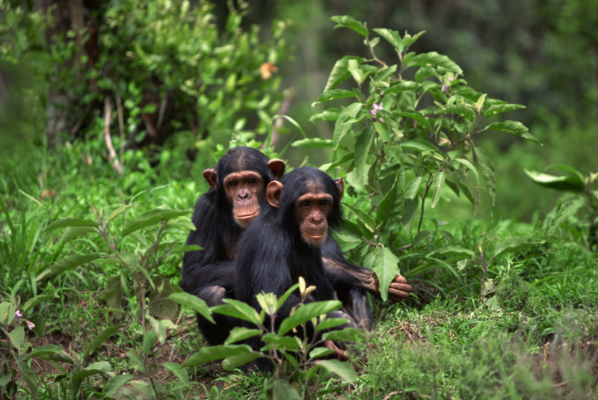
Selection for Bipedalism
Recent evidence suggests that bipedalism may have evolved while early hominins, such as Ardipithecus ramidus and Orrorin tugenensis, were still living in a forested environment (a habitat currently occupied by chimps).

Slide 10
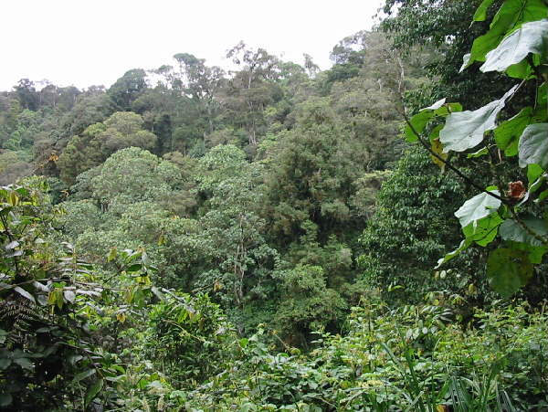
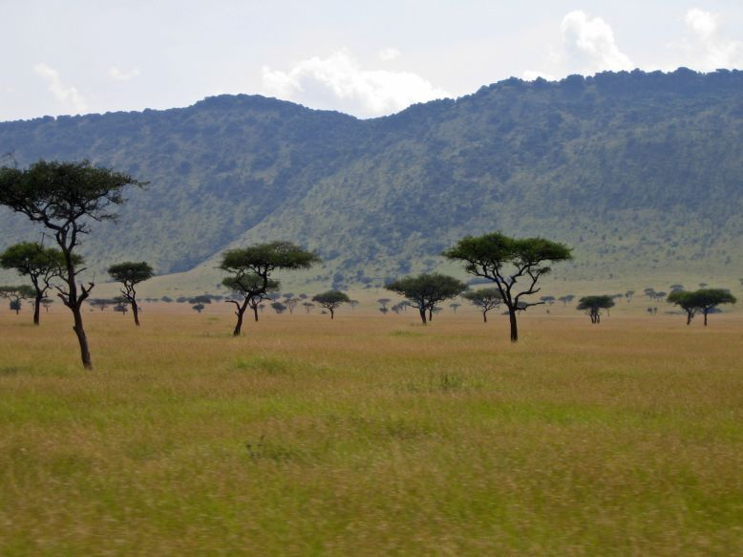
Selection for Bipedalism
As the climate and habitat changed, pre-hominins may have been forced to move across open ground to exploit their dwindling food resources amongst the trees.
They would also have had to experiment with new food resources in the wooded savannah.
Near-Continuous Forest
Wooded Savannah

Slide 11
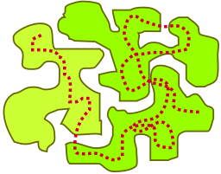
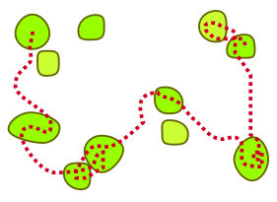
Selection for Bipedalism
Near-Continuous Forest
Pre-hominins foraged for food in nearly continuous forest – food resources were readily available.
A near completely arboreal life was possible.
A cooling climate caused the habitat to change in the late Miocene
Wooded Savannah
By the late Miocene, the pre-hominins were faced with a very different habitat of widely separated trees.
Pre-hominins were forced to leave the trees in order to seek out diminishing resources.

Slide 12
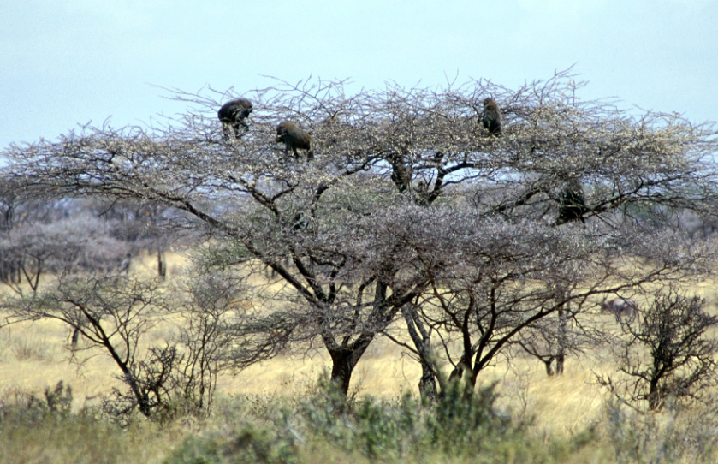
Selection for Bipedalism
As the climate and habitat changed, pre-hominins may have been forced to move across open ground to exploit their dwindling food resources amongst the trees.
They would also have had to experiment with new food resources in the wooded savannah.
Wooded Savannah
A troop of baboons foraging in an acacia tree on the East African savannah

Slide 13
LUCY

Slide 14
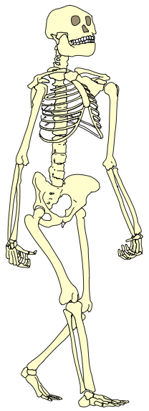
The Primitive Features of 'Lucy'
This is a reconstructed skeleton of ‘Lucy’ Australopithecus afarensis – one of the earliest known bipedal hominins.
The skeleton exhibits features consistent with a species adapted for walking bipedally ....
But it also possesses many ‘primitive’ features normally associated with an arboreal existence.
Jaw shape half way between V-shape of ape's and U-shape of human jaw
Sexual dimorphism in the canine teeth (a primitive trait)
Shoulder joint that is orientated towards the head
Chest (thorax) is funnel-shaped
Relatively long arms compared to legs
Wrist has high mobility
Finger bones are curved
Relatively short legs
Ankle joint is highly mobile
Toes are long and curved
Redrawn from a photograph by © David L. Brill 1985

Slide 15
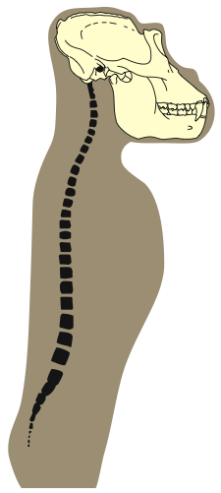
Changes in Spine Anatomy
Foramen magnum is further forward so skull is balanced on spine
The lower spine has become S-shaped to accommodate the upright walking posture.
Compare the spine shapes of:
gorilla - adapted to quadrupedal movement
human - adapted to bipedal locomotion
Forward curvature
Straight spine
S-shaped spine that acts like a spring
Gorilla Spine
Human Spine

Slide 16
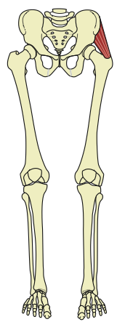
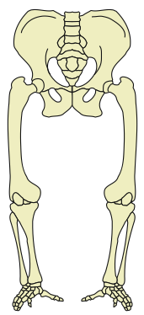
Changes in Locomotion
Human lower limbs have been highly modified for bipedal locomotion:
legs are longer than arms
lower and broader pelvis
inwardly-angled femur
strong knee joint
a platform foot
By comparison, an ape’s lower limbs feature:
a long pelvis
an outwardly-angled femur
grasping toes
Apes are only capable of producing a bow-legged, body-rocking bipedal waddle.
Gorilla Legs
Human Legs

Slide 17
The Carrying Angle
Gluteus muscles of the hip lift the short, wide pelvis to prevent tilting when the opposite leg is off the ground
The femoral head is angled and strengthened
The thigh bone is angled outwards from knee
Increased carrying (valgus) angle ensures the knee is brought well under the body during walking
The thigh bone is at right angles to knee
Gorilla Legs
Human Legs

Slide 18
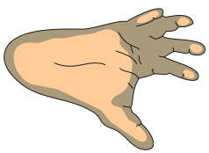
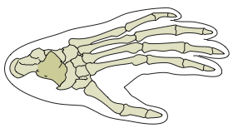
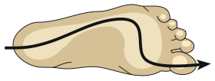
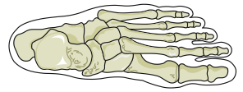
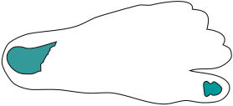
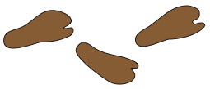
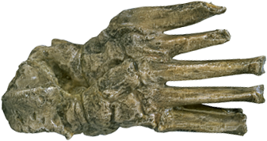
Changes in Foot Anatomy
Chimpanzee Foot
The human foot has undergone considerable modification to make it better suited to a walking mode of locomotion:
Toes became reduced in length and are no longer curved. The big toe is no longer opposable.
A transverse arch converts the foot into a spring allowing it to transmit the stresses of walking and improve walking efficiency.
Curved toe bones
Lighter shading represents points of contact with the ground
Big toe diverges
(separate from other toes)
Human Foot
Lighter shading represents points of contact with the ground
Direction of weight transmission in walking
Big toe aligned with other toes
Australopithecine Footprints
Footprints thought to belong to an Australopithecine at Laetoli dated at 3.7 mya
Heel bone missing from fossil
Foot bones (OH8) from Bed I at Olduvai Gorge

Slide 19
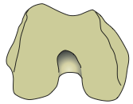
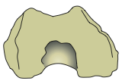
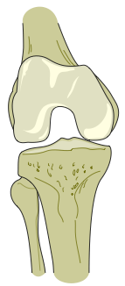
Changes in Knee Anatomy
Lower end of femur
In modern humans, the knee joint is adapted to bear weight through the lateral condyles, which are larger than the medial condyles.
In chimpanzees, the knee joint is adapted to bear weight through the medial condyles.
Chimpanzee
Human
Australopithecine
Buttress of bone to prevent the sideways deflection of leg muscles
Medial condyle higher and larger
Condyles not like either of the other two
Lateral condyle is larger
Femur (thigh bone)
Lower end of femur (as shown above)
Lateral (outer) condyle
Medial (inner) condyle
The front view of a modern human right knee joint shown in a bent position (the knee cap has been removed for clarity):
Fibula
Tibia

Slide 20
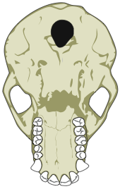
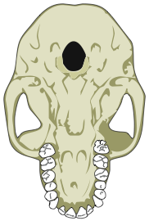
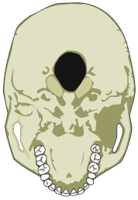
Changes in the Skull Base
Foramen magnum
An important diagnostic feature bipedalism is the position of the foramen magnum on the base of the skull.
The foramen magnum is the attachment point for the skull and the spine through which the spinal cord passes to the brain.
An opening close to the rear of the skull implies a quadrupedal habit of locomotion: the head is held upright by powerful neck muscles.
An opening located more centrally on the skull, as is found in modern humans, indicates a bipedal habit of locomotion: the head balances on the spine and less powerful neck muscles.
Chimpanzee
Opening is near the rear of the skull suggesting a quadrupedal habit
Australopithecine
Opening is located closer to the position of that found on modern human skulls
Human
Opening near the central pivoting point of the skull allowing it to balance

Slide 21
Changes in Dentition
An important diagnostic feature of ‘humanness’ are the shape and arrangement of teeth.
Chimpanzee
Bottom view of skull:
Australopithecine
Bottom view of skull:
Human
Bottom view of skull:
Diastema
Dental arch is U-shaped
Canines are very large
Other teeth are large
Diastema (gap) present
Dental arch is still slightly U-shaped
Canines are reduced
Other teeth are large
Diastema (gap) present
Dental arch is less U-shaped
All teeth are smaller
No diastema (gap)

Slide 22
Changes in Prognathism
Apes and early hominins have a forward jutting jaw, known as prognathism, as well as a prominent brow ridge.
Over time hominins have gradually moved to having a flatter face with increased development of a chin and nose.
There has also been an increase in the size of the forehead which has become larger and flatter to accommodate an increase in cerebral cortex size.

Slide 24
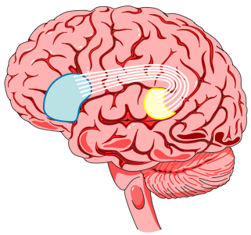
Evolution of the Human Brain
Intelligence is not just a function of brain size: relative brain size appears to be more important (brain size compared to body size).
Modern humans have a brain volume three times larger than that predicted for an average monkey or ape with our body size.
Another important factor is the organization of the brain, evident in the development of the areas concerned with spoken language.
Two areas of the brain have become highly developed in modern humans:
Broca’s area concerned with speech
Wernicke’s area concerned with comprehension of language.

Slide 25
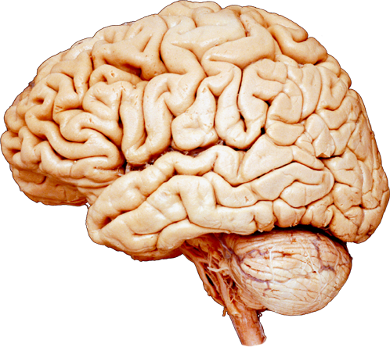
Modern Human Brain
Frontal lobe
Broca’s Area
Controls the muscles of the lips, jaw, tongue, soft palate and vocal cords during speech
Cerebellum
Wernicke’s Area
Area of the brain concerned with the comprehension of spoken words - the ability to listen

Slide 26
Changes in Brain Size
Selection pressures for increased brain size must have been considerable.
The normal human adult brain averages around 1330 cc, but ranges in size between 1000 and 2000 cc.
Brain Volume for Hominin Species
Hominin Species | Years Ago (mya) | Average Brain Volume (ml)
Australopithecus afarensis | 3.5 | 440
Australopithecus africanus | 2.5 | 450
Paranthropus robustus | 2.0 | 520
Paranthropus boisei | 1.5 | 515
Homo rudolfensis | 2.0 | 700
Homo habilis | 1.8 | 575
Homo ergaster | 1.8 | 800
Homo erectus | 0.5 | 1100
Homo heidelbergensis | 0.2 | 1250
Homo neanderthalensis | 0.05 | 1550
Homo floresiensis | 0.095 | 380*
Early Homo sapiens | 0.08 | 1450
* Note that Homo floresiensis is well outside the normal range for humans

Slide 27
Changes in Brain Size
Changes in Hominin Brain Volume Over Time
Second burst of brain expansion
Mean volume of 1330cc for living humans
Estimated Brain Volume (ml)
Mean volume of 400cc for Chimpanzees
First burst of brain expansion
Homo floresiensis
Millions of Years Ago

Slide 28
Brain Size Compared to Body Height
Brain size can be correlated to the body height of hominins.
A clear pattern emerges that indicates three distinct clusters of evolutionary development:
Australopithecines
Erectines
Homo
Homo floresiensis clearly falls out side these clusters.
Homo sapiens
Brain Volume (ml)
Erectines
Australopithecines
Homo floresiensis
Height (m)

